Slide 1


Informatics Bootcamp #1: Healthcare Informatics
Led by
Dr. Metin Gurcan,
Dr. Arezoo Movaghar,
Dr. Mostafa Rezapour
May 28, 2024

Slide 2
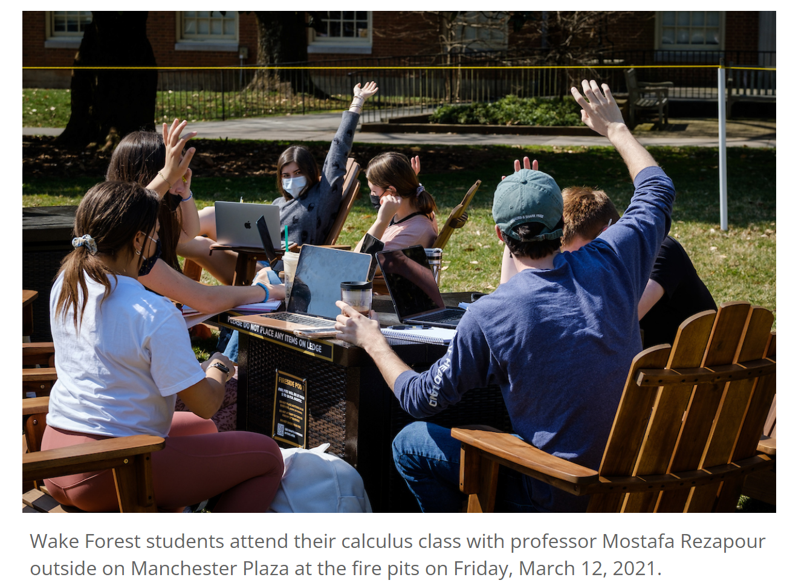
The Future of Healthcare: AI at the Forefront
Question:
Can artificial intelligence techniques transform how clinicians assess and treat patients?

Slide 3
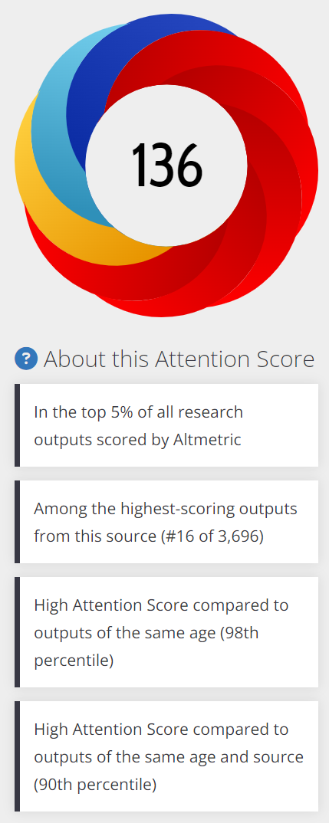




The Future of Healthcare: AI at the Forefront

Slide 4

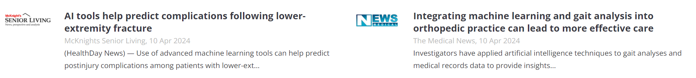

The Future of Healthcare: AI at the Forefront

Slide 5


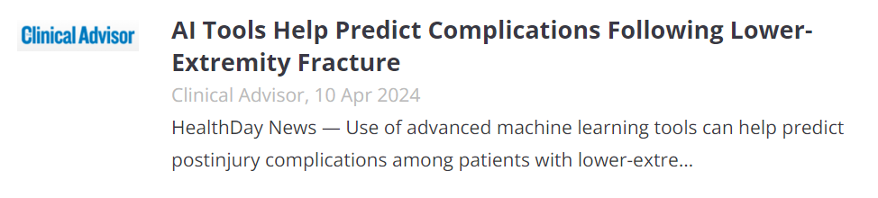

The Future of Healthcare: AI at the Forefront
A team of researchers at Wake Forest University School of Medicine attempted to quantify the ways ML could improve the treatment of patients recovering from lower extremity fractures and published their findings in the Journal of Orthopaedic Research.

Slide 6
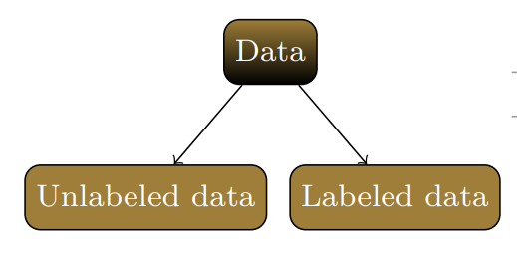
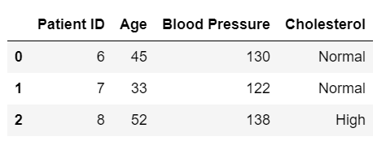
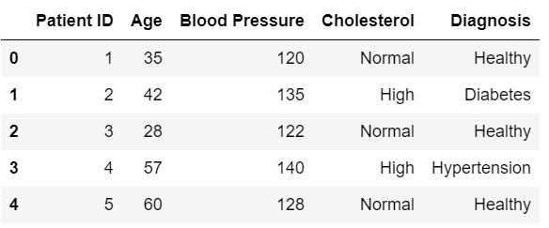
Labeled vs Unlabeled Data

Slide 7
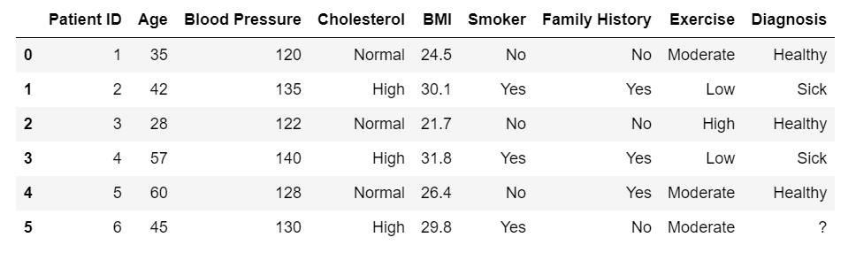
Labeled Data: Prediction

Slide 8
Labeled Data: Prediction
Let's learn from the rest of the labeled data with known labels and identify similarities

Slide 9
Labeled Data: Prediction
Let's learn from the rest of the labeled data with known labels and identify similarities

Slide 10
Labeled Data: Prediction
Let's learn from the rest of the labeled data with known labels and identify similarities

Slide 11
Labeled Data: Prediction
Let's learn from the rest of the labeled data with known labels and identify similarities

Slide 12
Labeled Data: Prediction

Slide 13
Labeled Data: Prediction
?

Slide 14
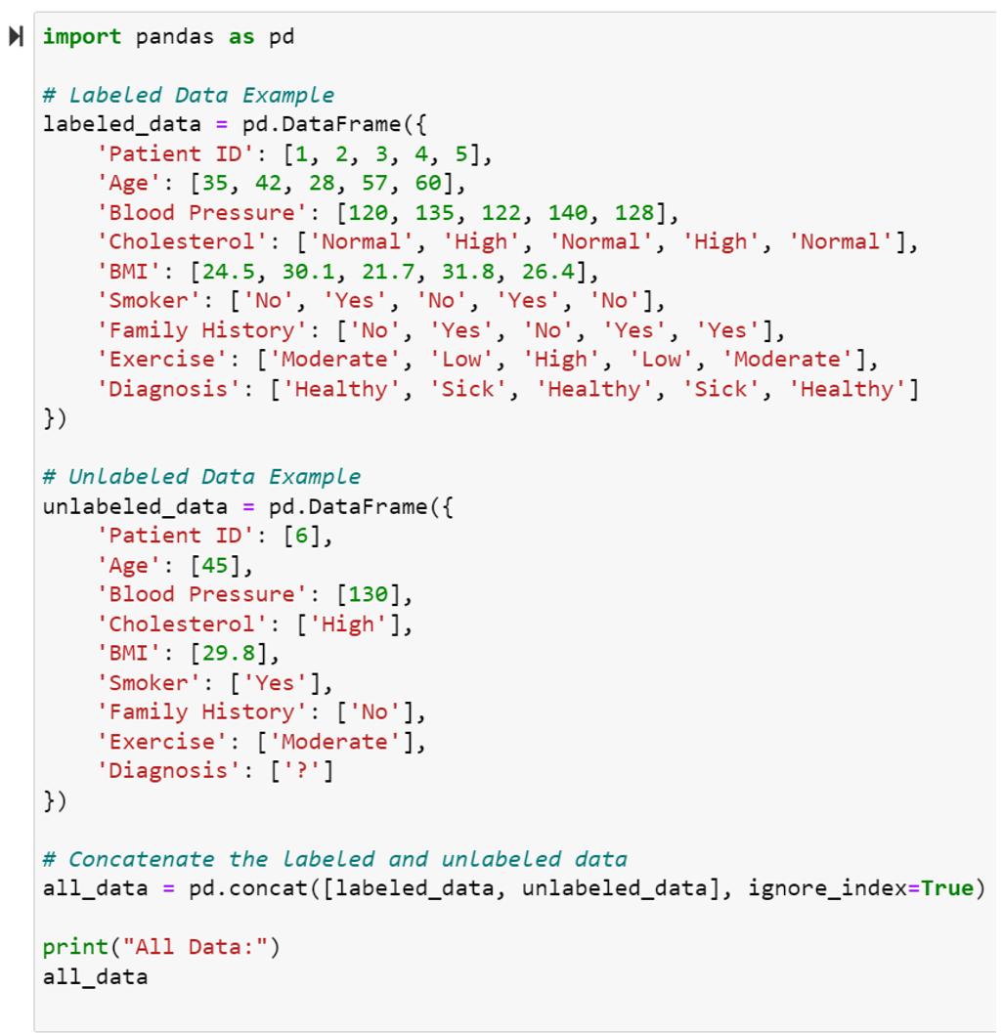
Training

Slide 15
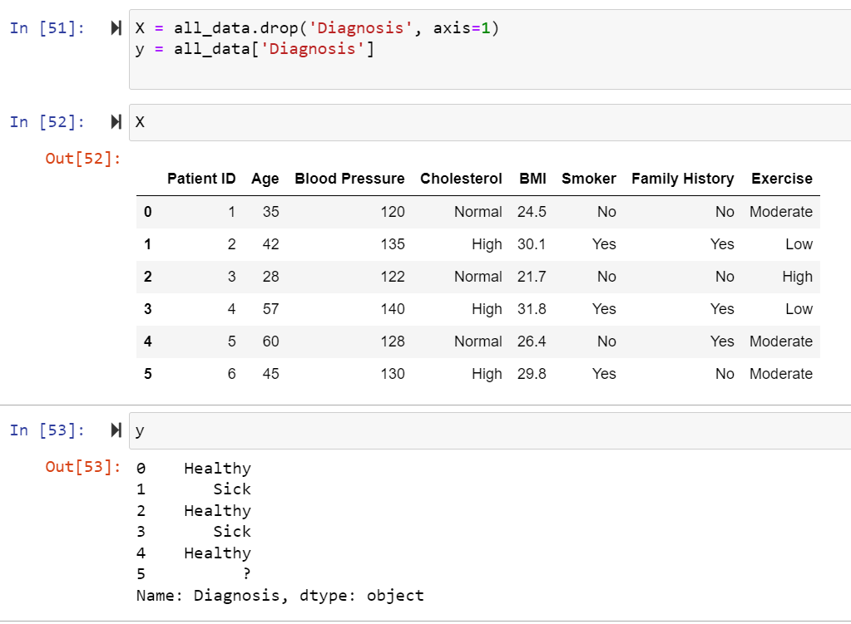

Slide 16
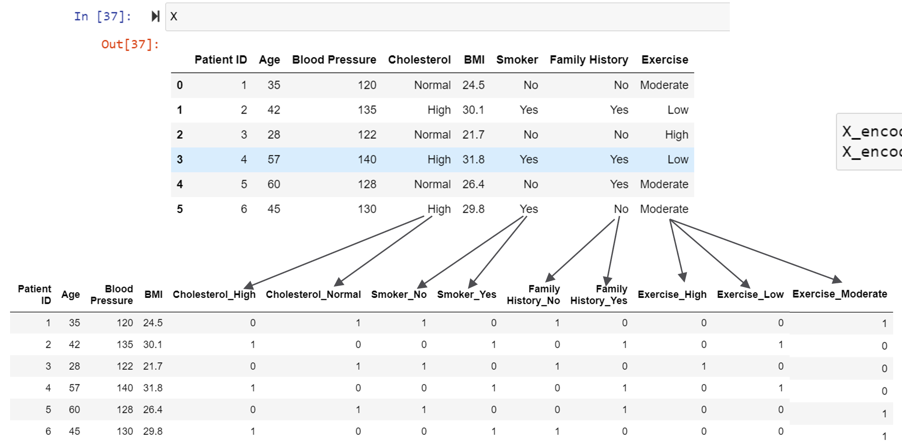

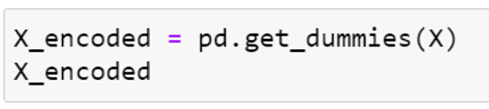

Slide 18
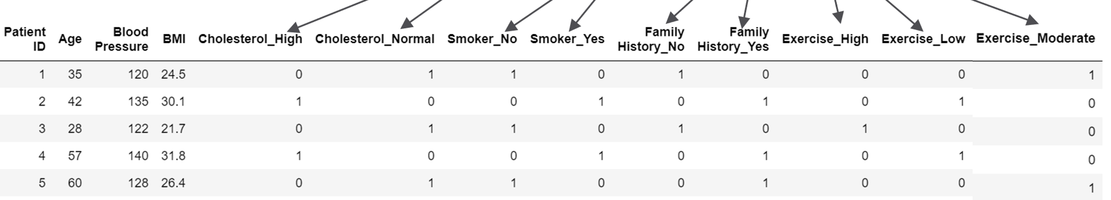
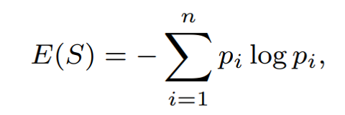
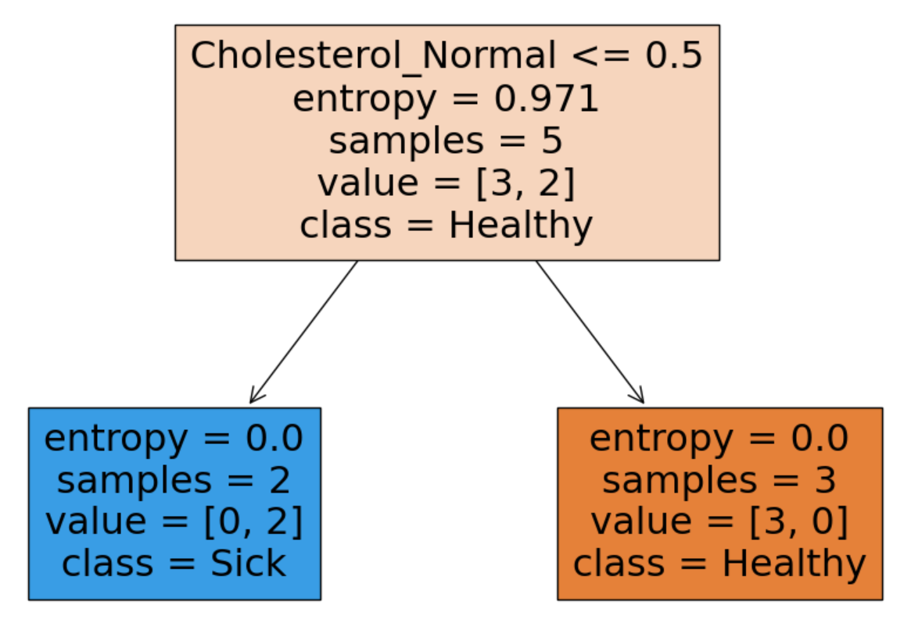
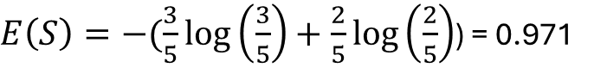
Healthy
Sick
$E\left(S\right)=−(\frac{3}{5}\log\left(\frac{3}{5}\right)+\frac{2}{5}\log\left(\frac{2}{5}\right)$) = 0.971
Yes
No

Slide 19
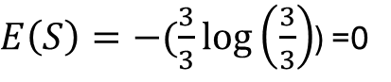
Healthy
Sick
Yes
No
$E\left(S\right)=−(\frac{3}{3}\log\left(\frac{3}{3}\right)$) =0

Slide 20
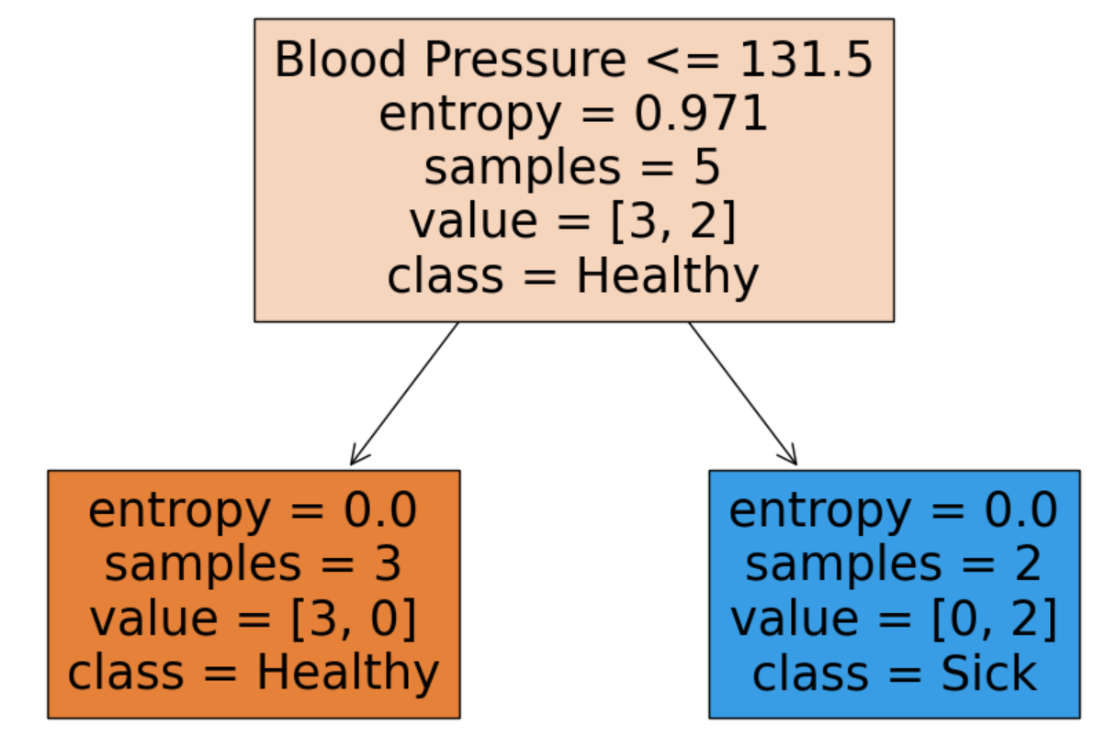
Healthy
Sick
Yes
No

Slide 21
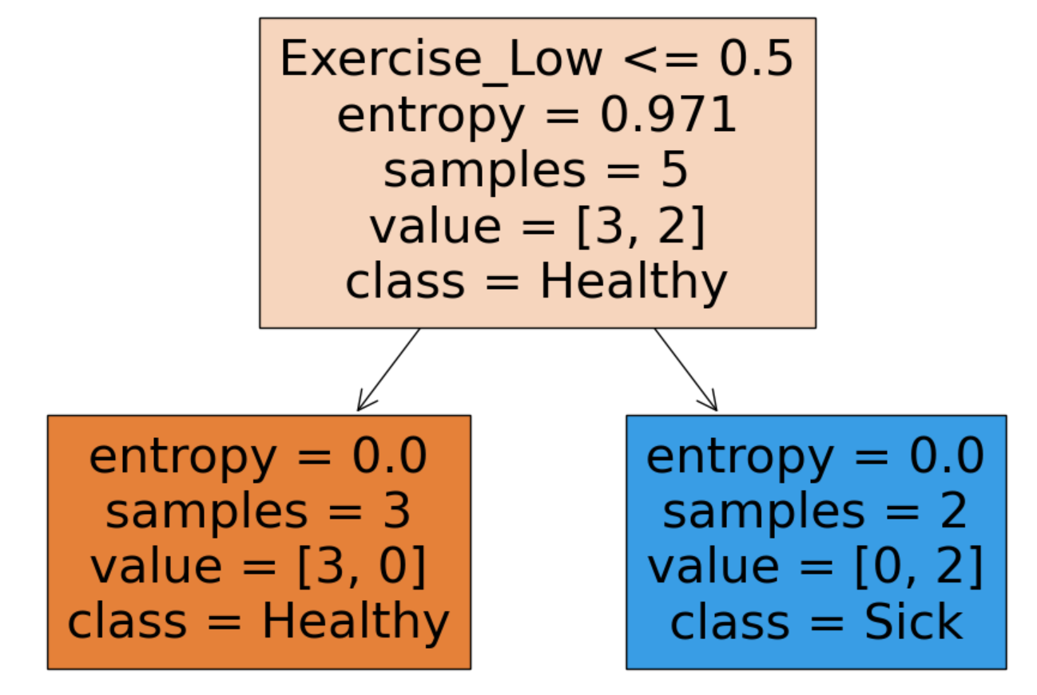
Yes
No

Slide 22
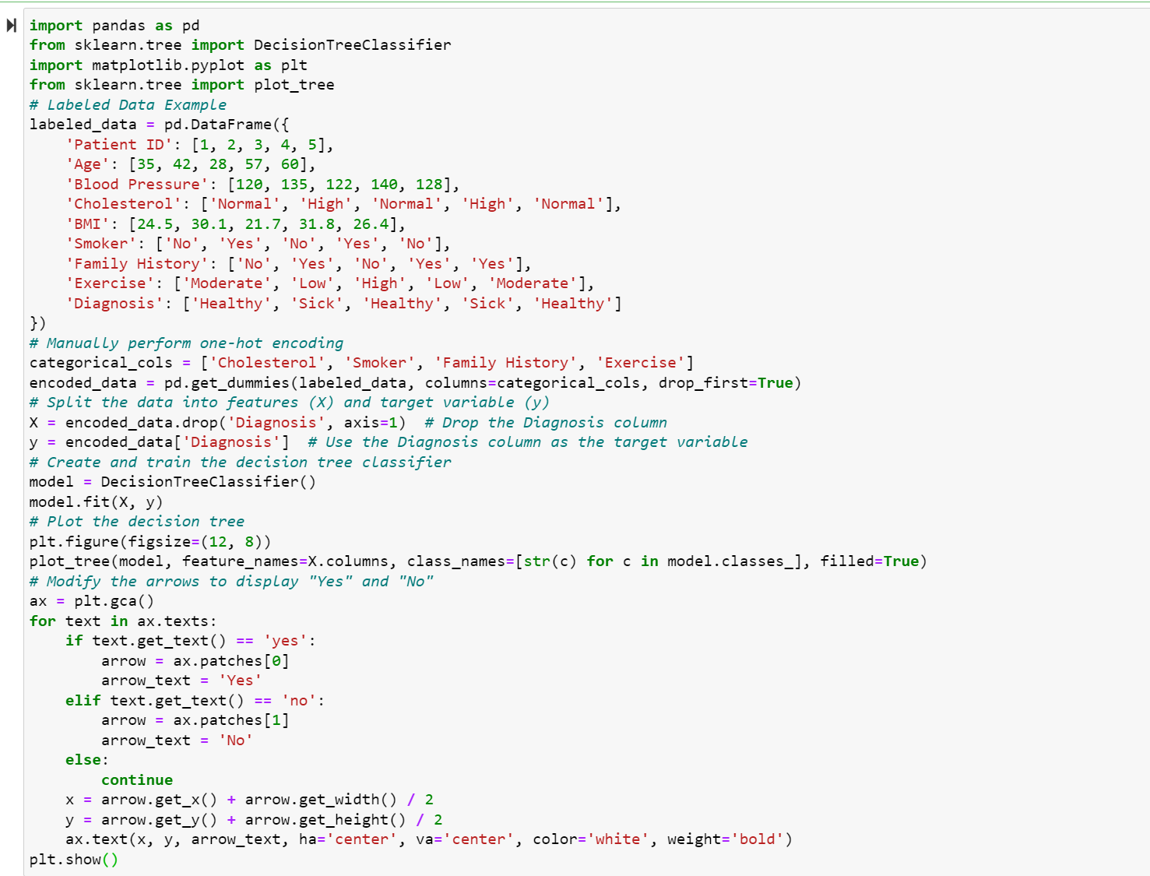
Decision Tree

Slide 23
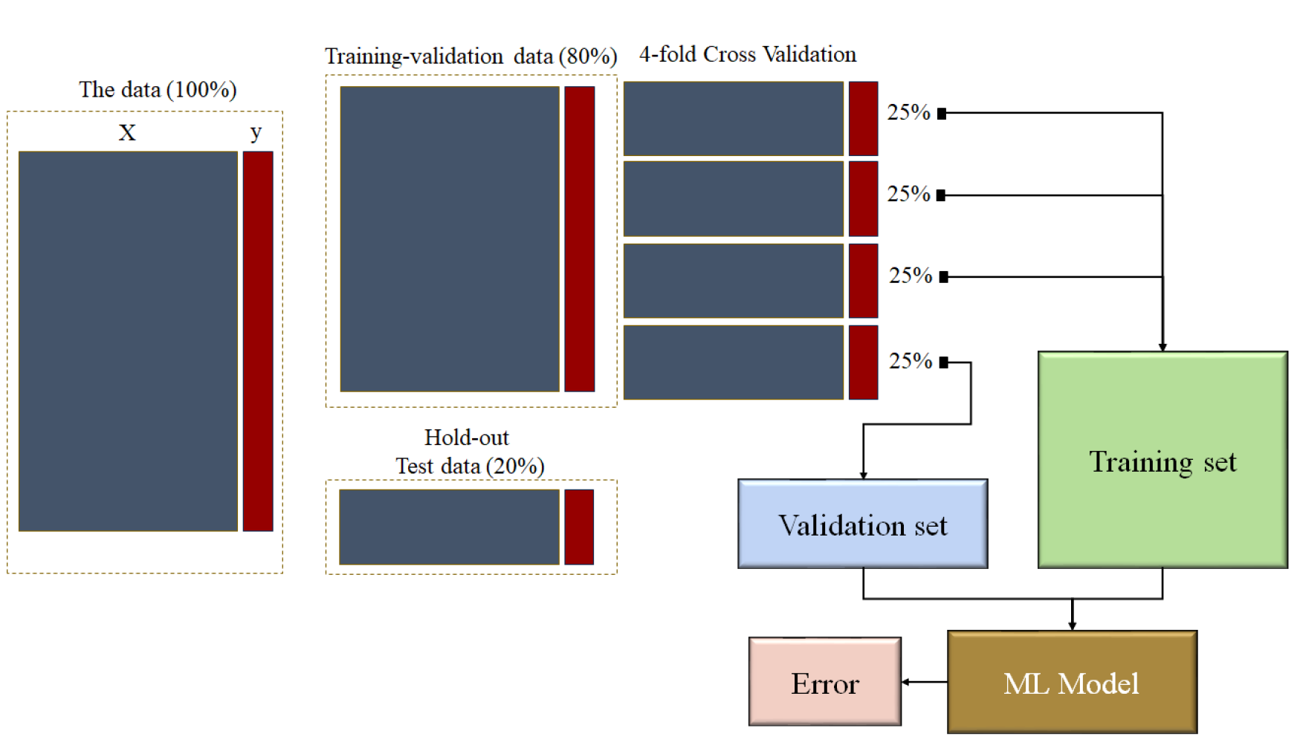


Slide 26
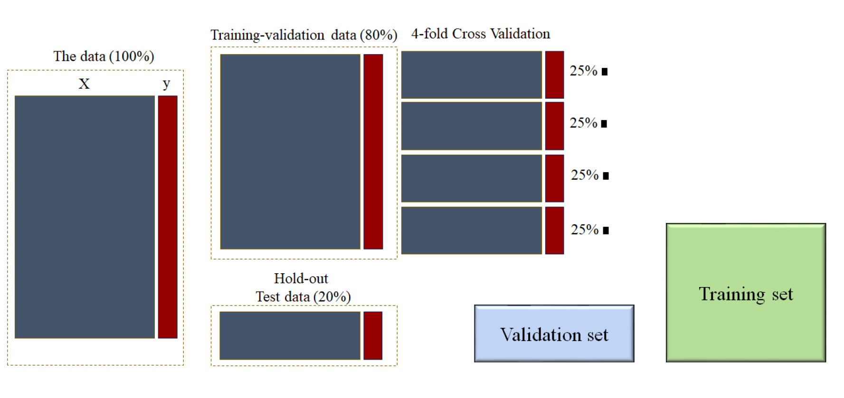

Slide 27
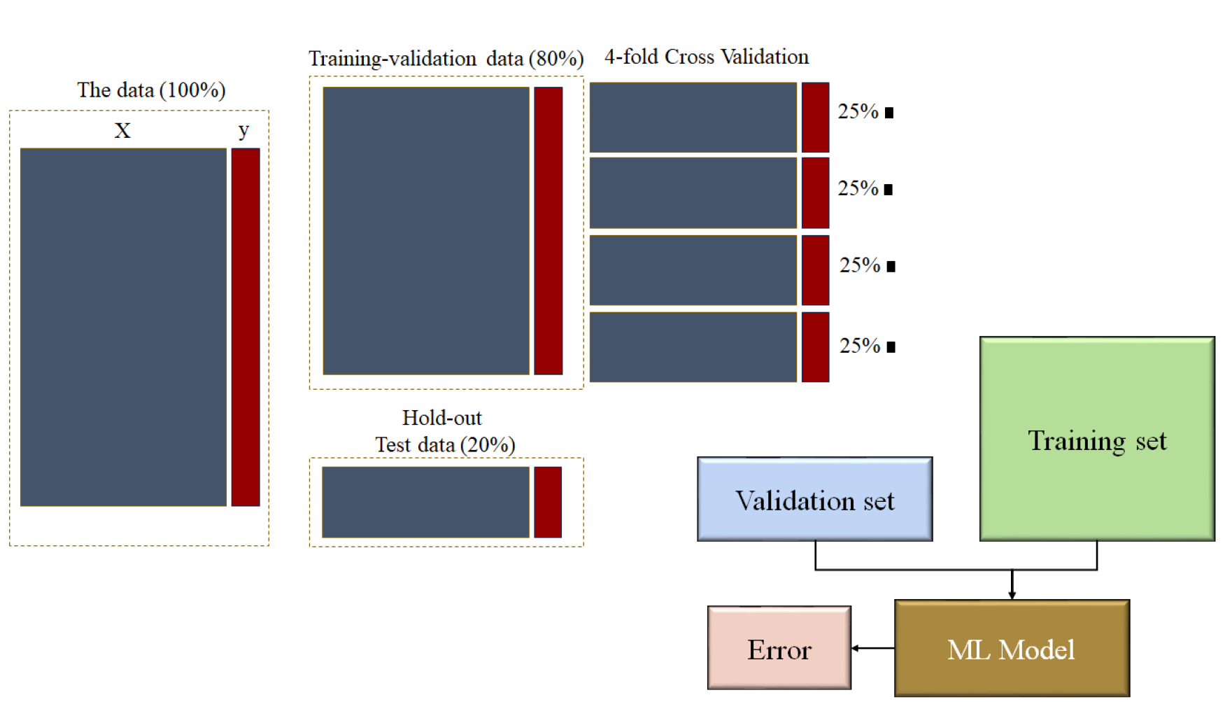

Slide 28
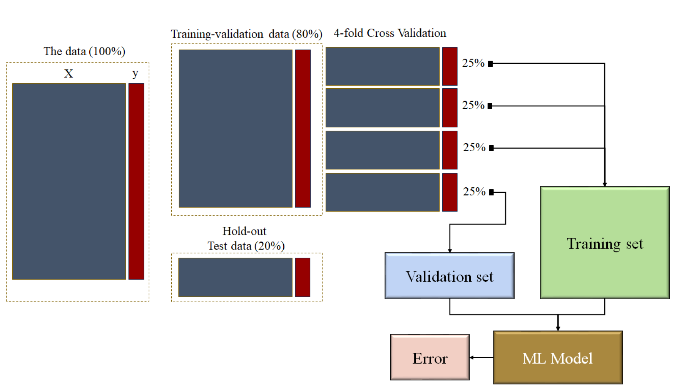

Slide 29
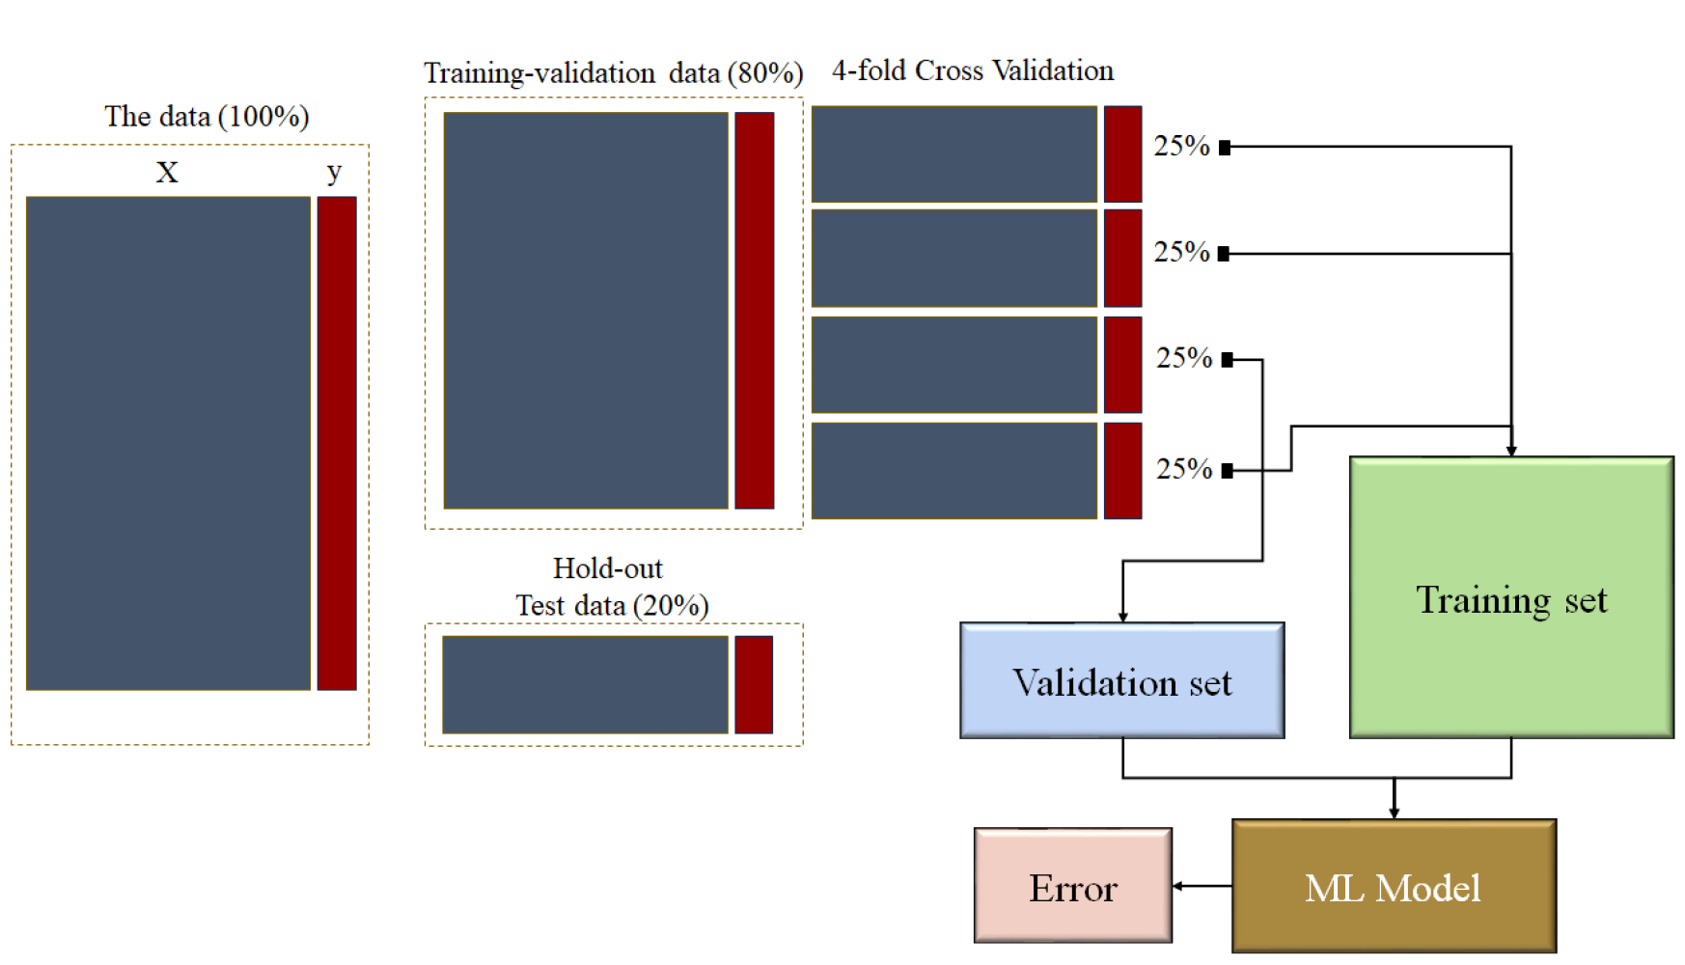

Slide 30
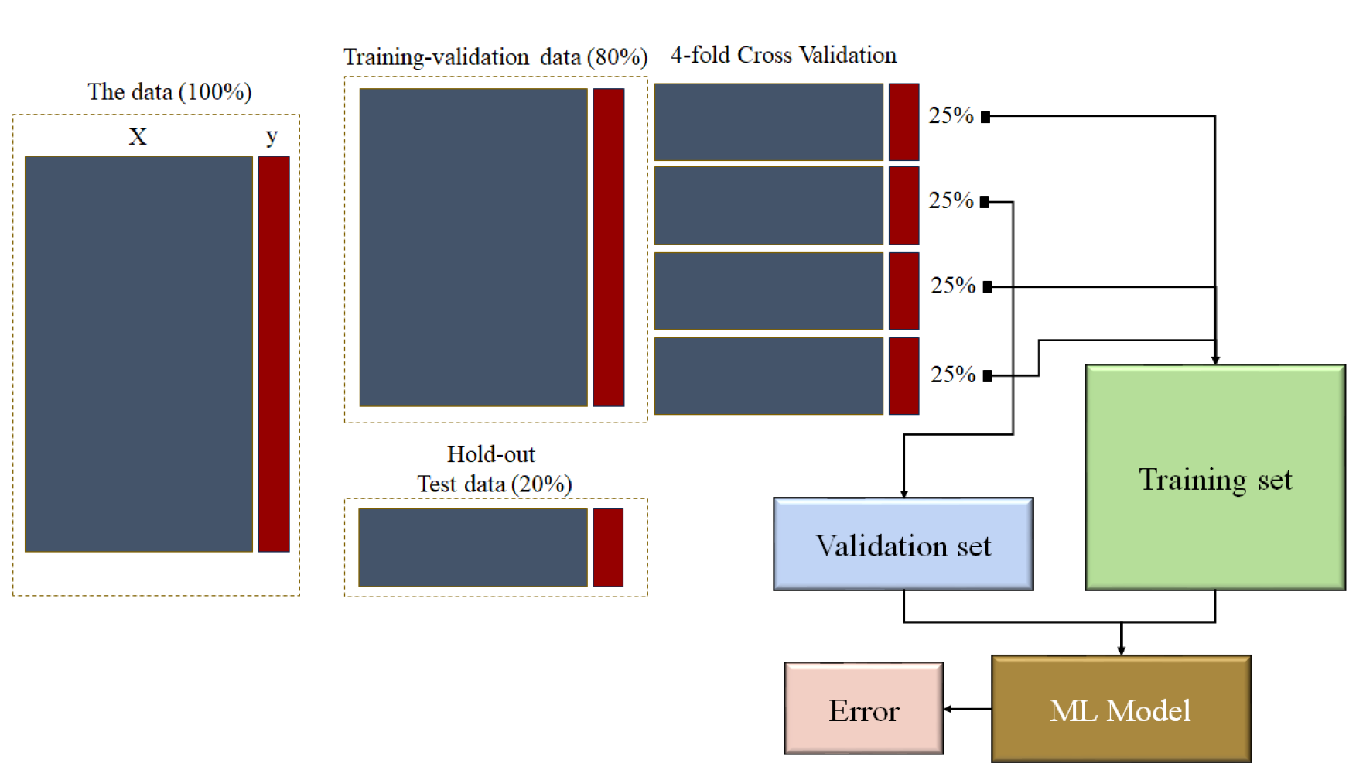

Slide 31
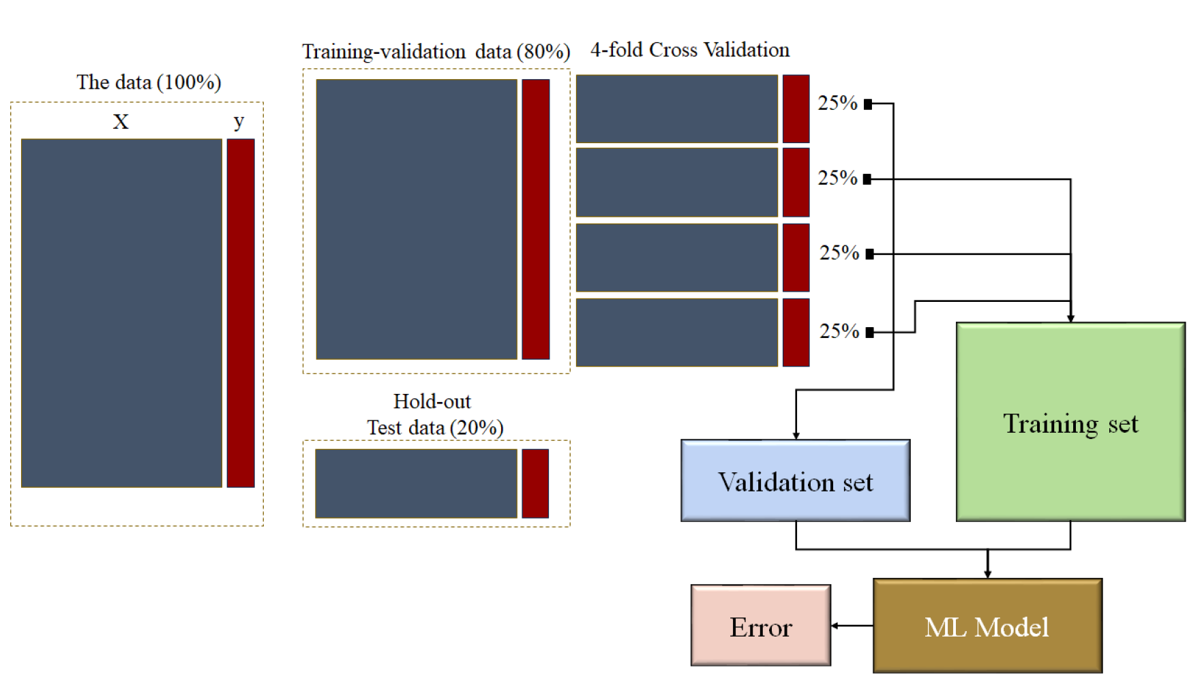

Slide 32
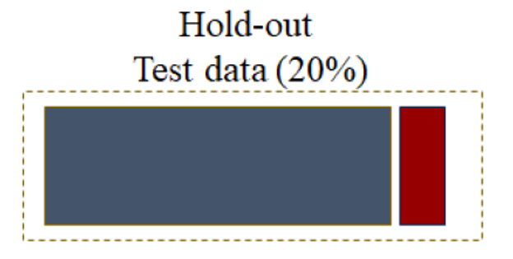

Test Performance

Slide 33
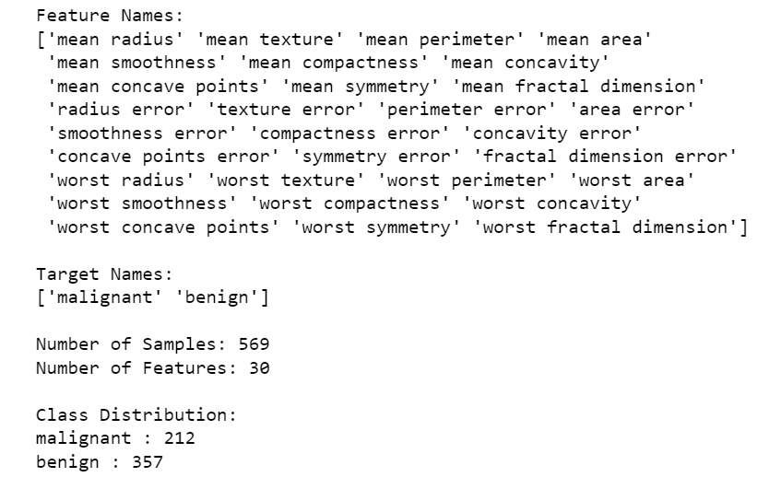
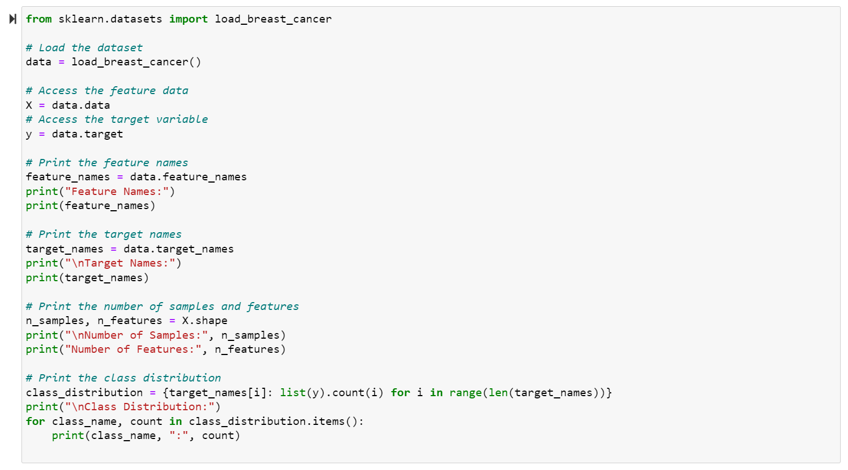
The Breast Cancer Wisconsin (Diagnostic) dataset

Slide 34
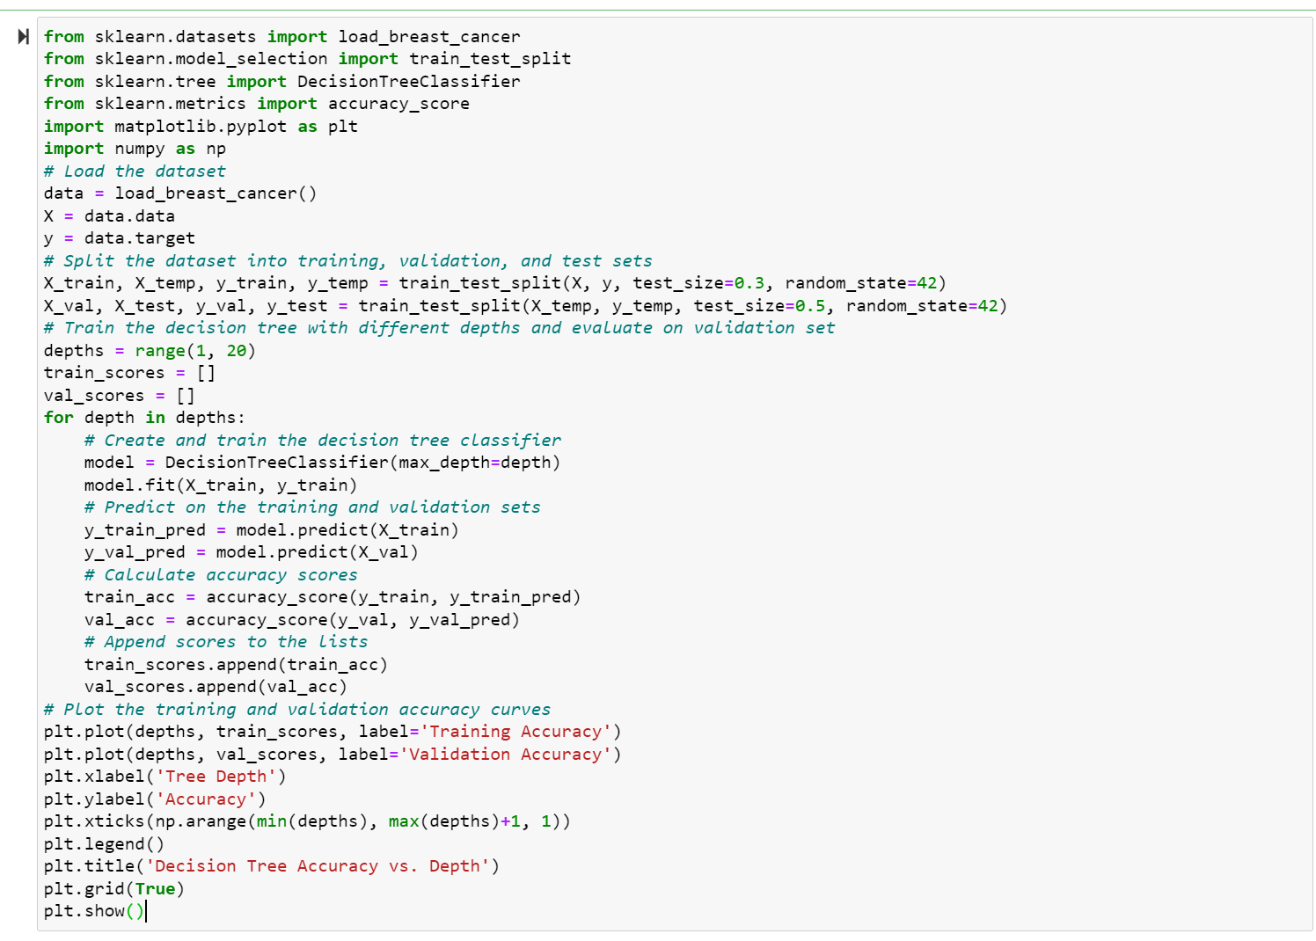

Slide 39
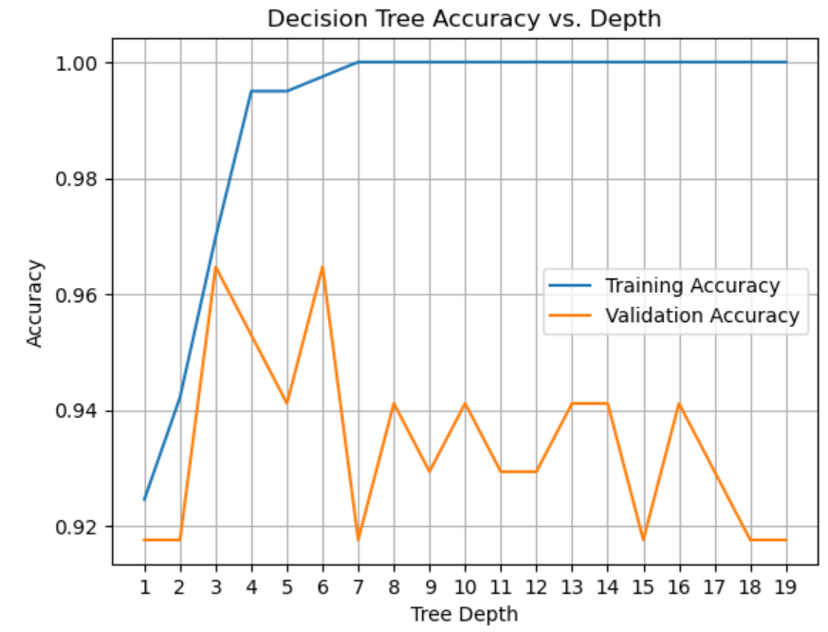

Slide 40
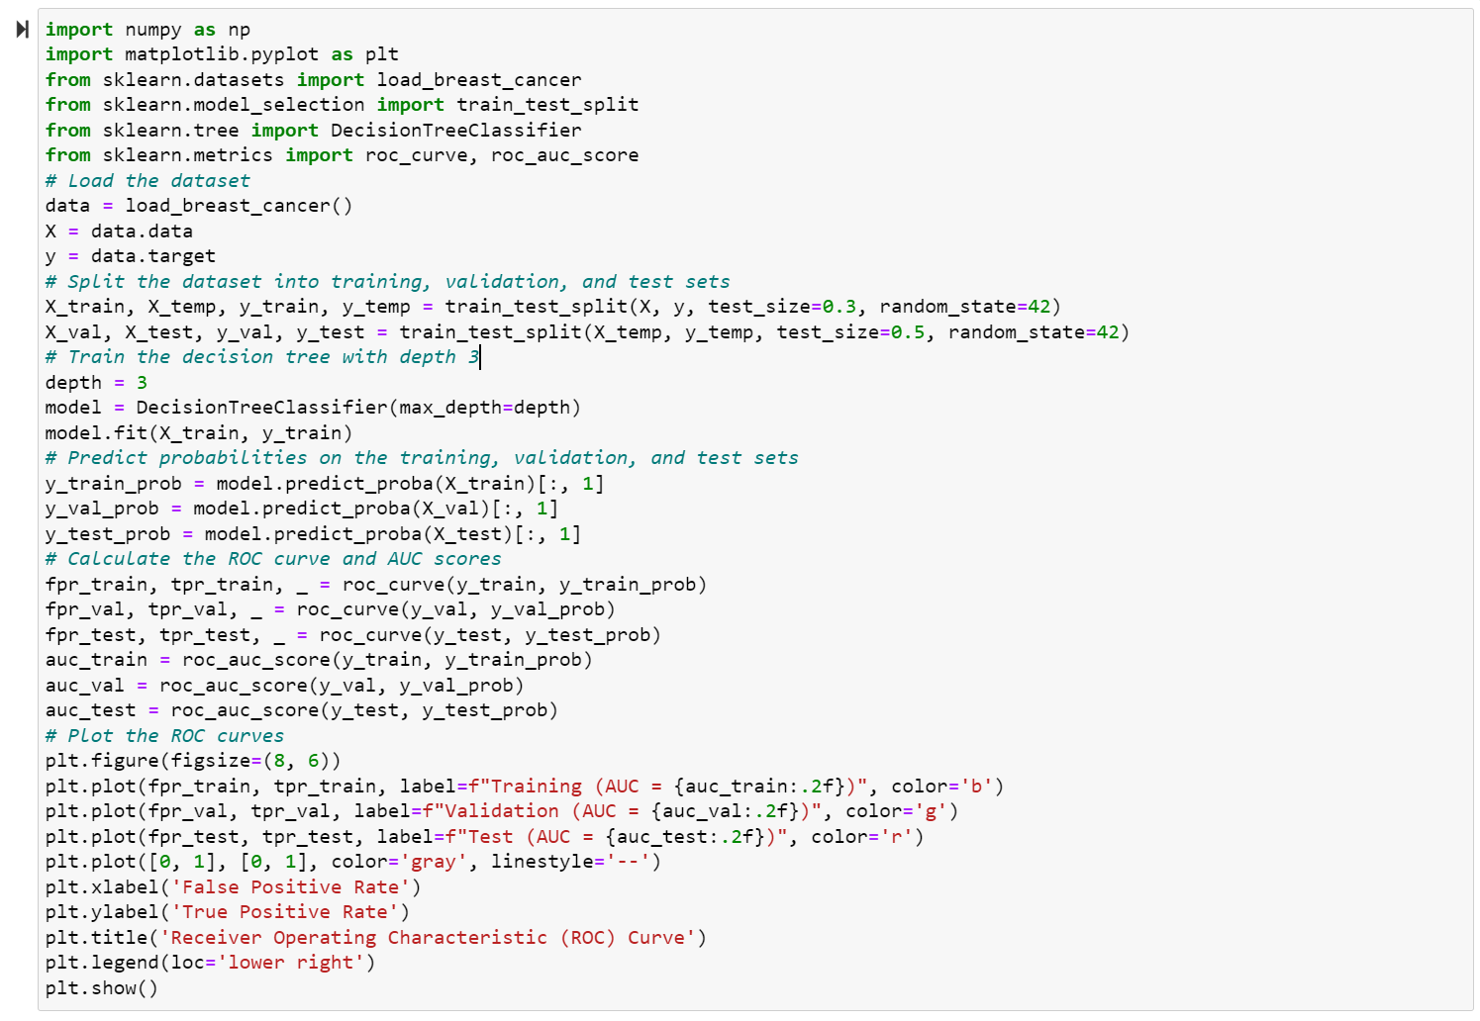

Slide 45
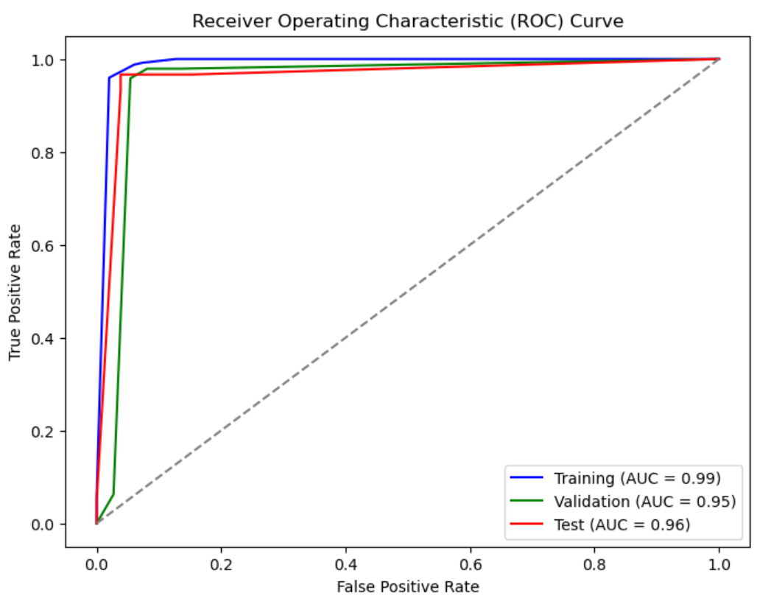

Slide 46
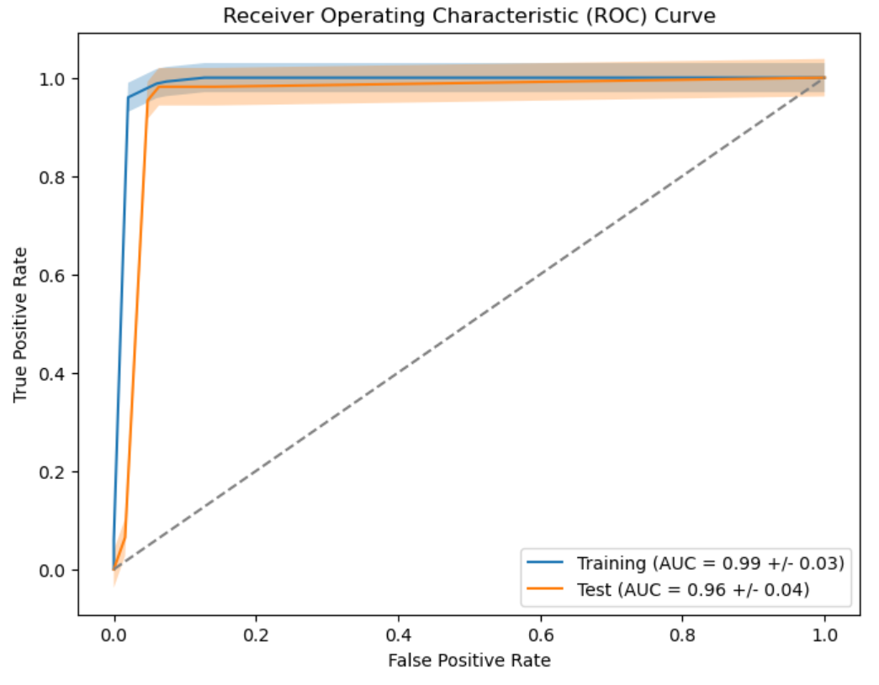
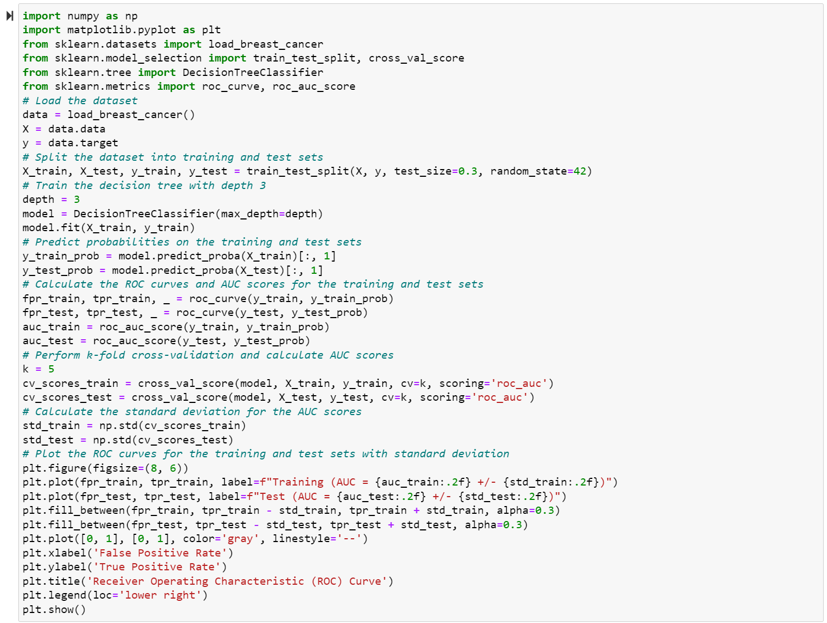
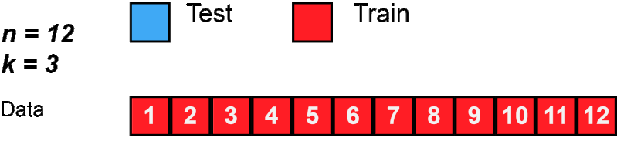
https://commons.wikimedia.org/wiki/File:KfoldCV.gif

Slide 47
Hands-On Experience
10 minutes

Slide 48
Real-World Applications of Decision Trees and Tree-Based Ensemble Models

Slide 49
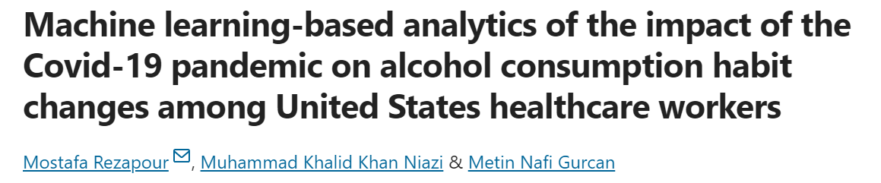

Slide 50

Data Source: Survey data from the University of Michigan’s ICPSR.

Slide 51
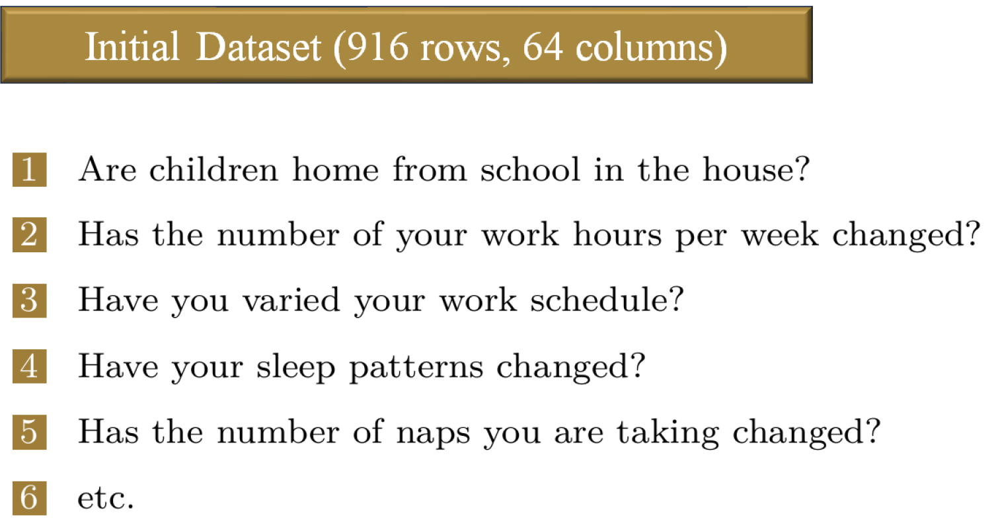


Slide 52
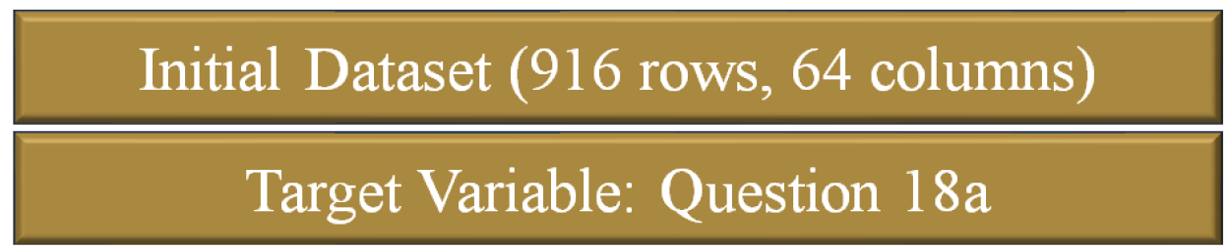
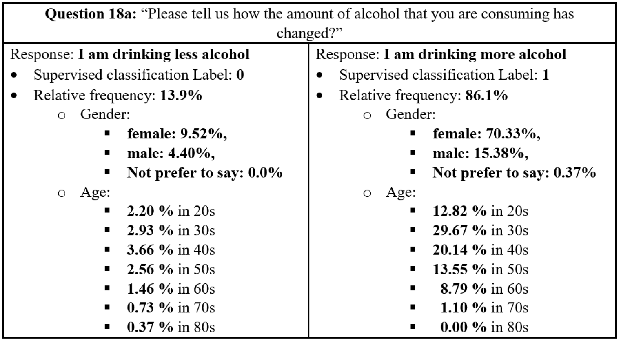

Slide 53

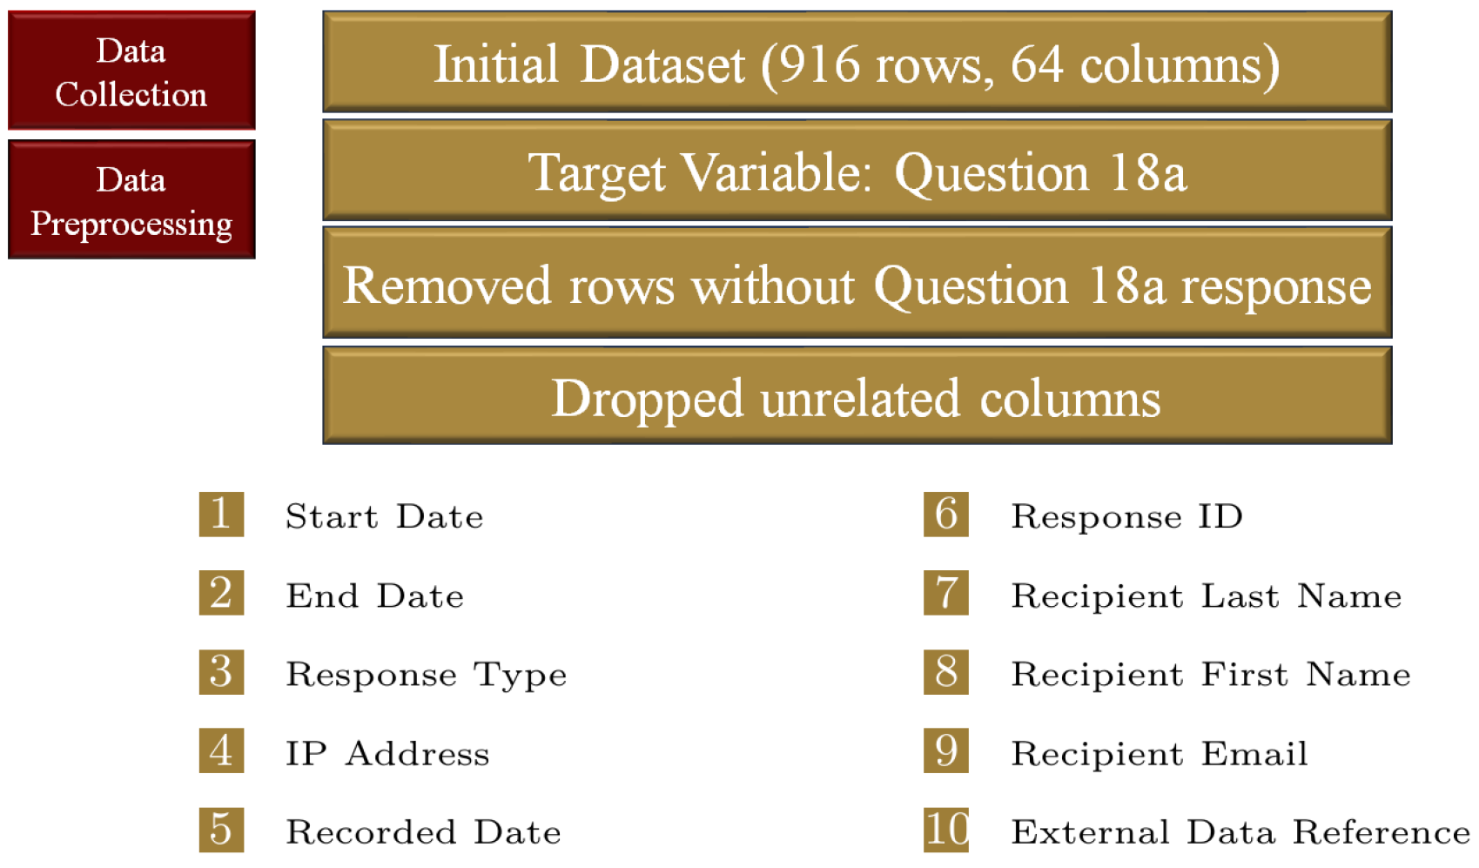

Slide 54
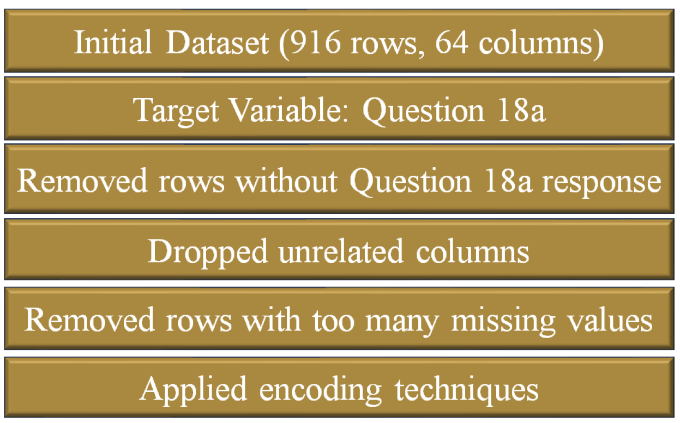

Slide 55
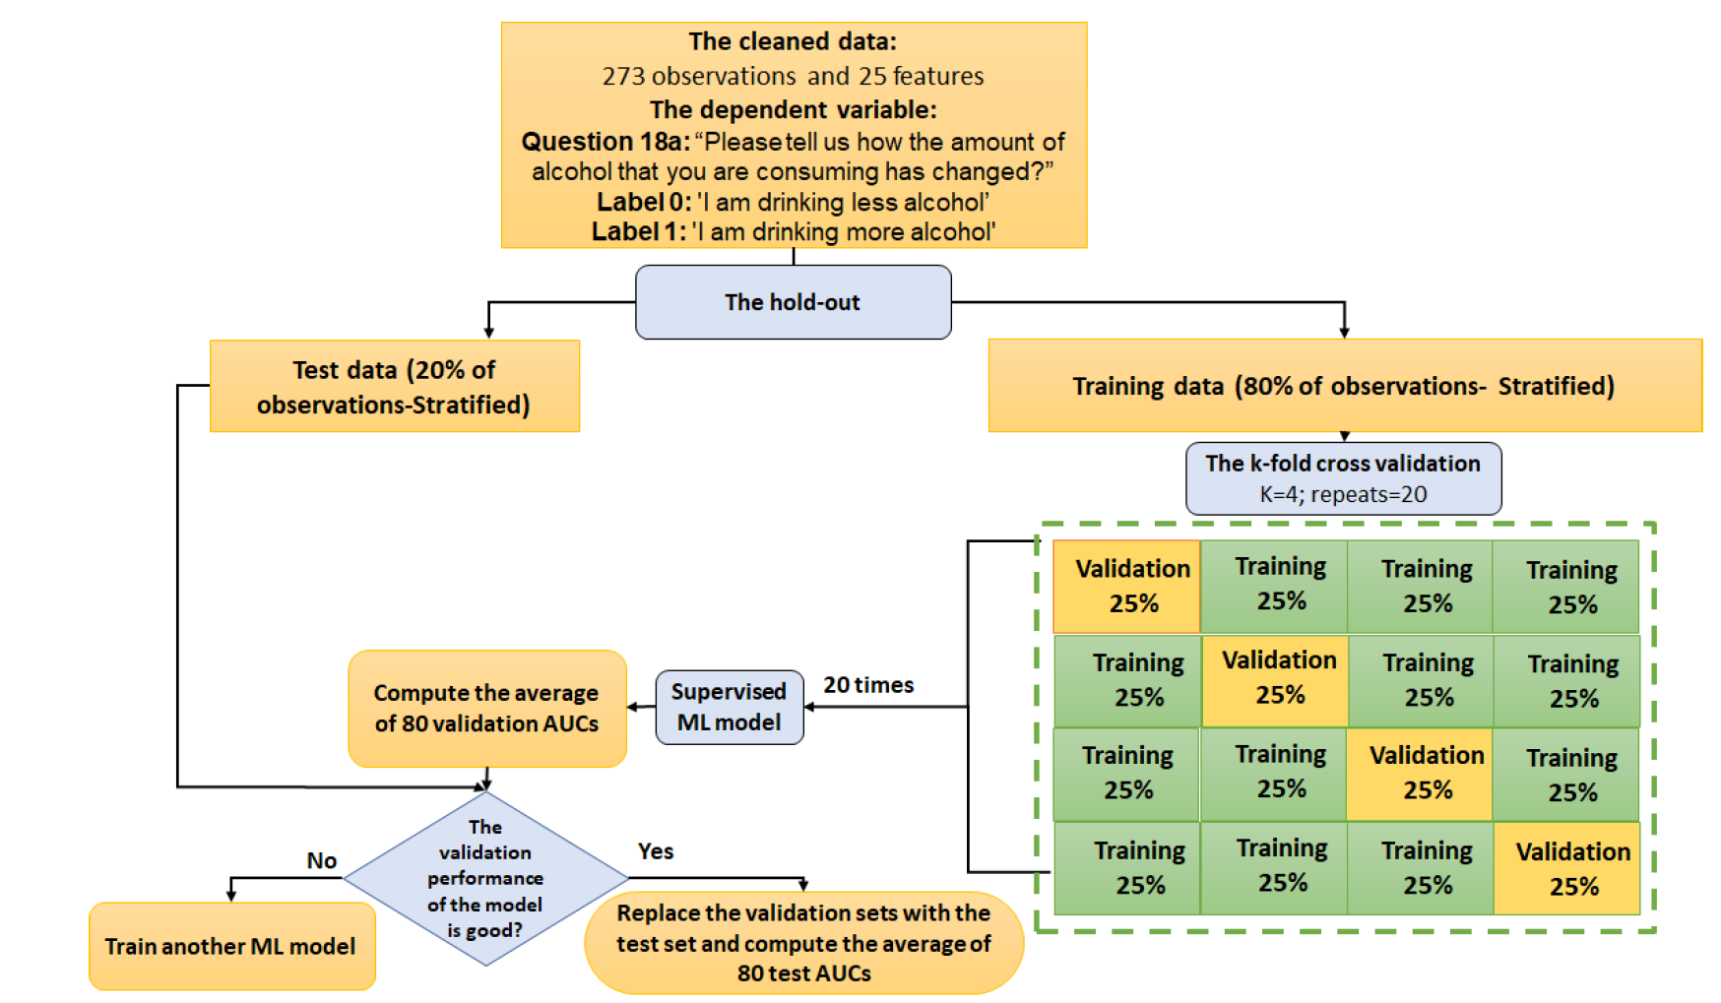

Slide 56
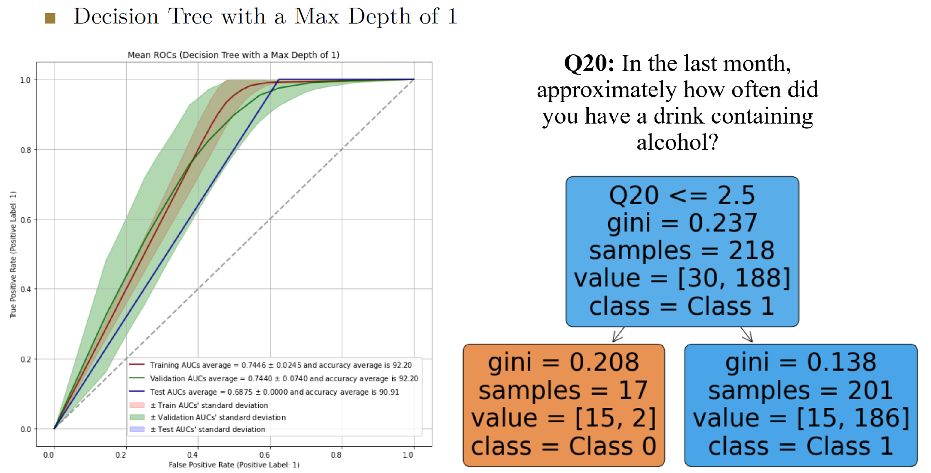
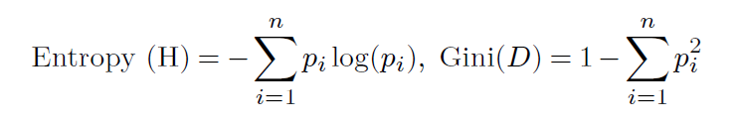

Slide 57
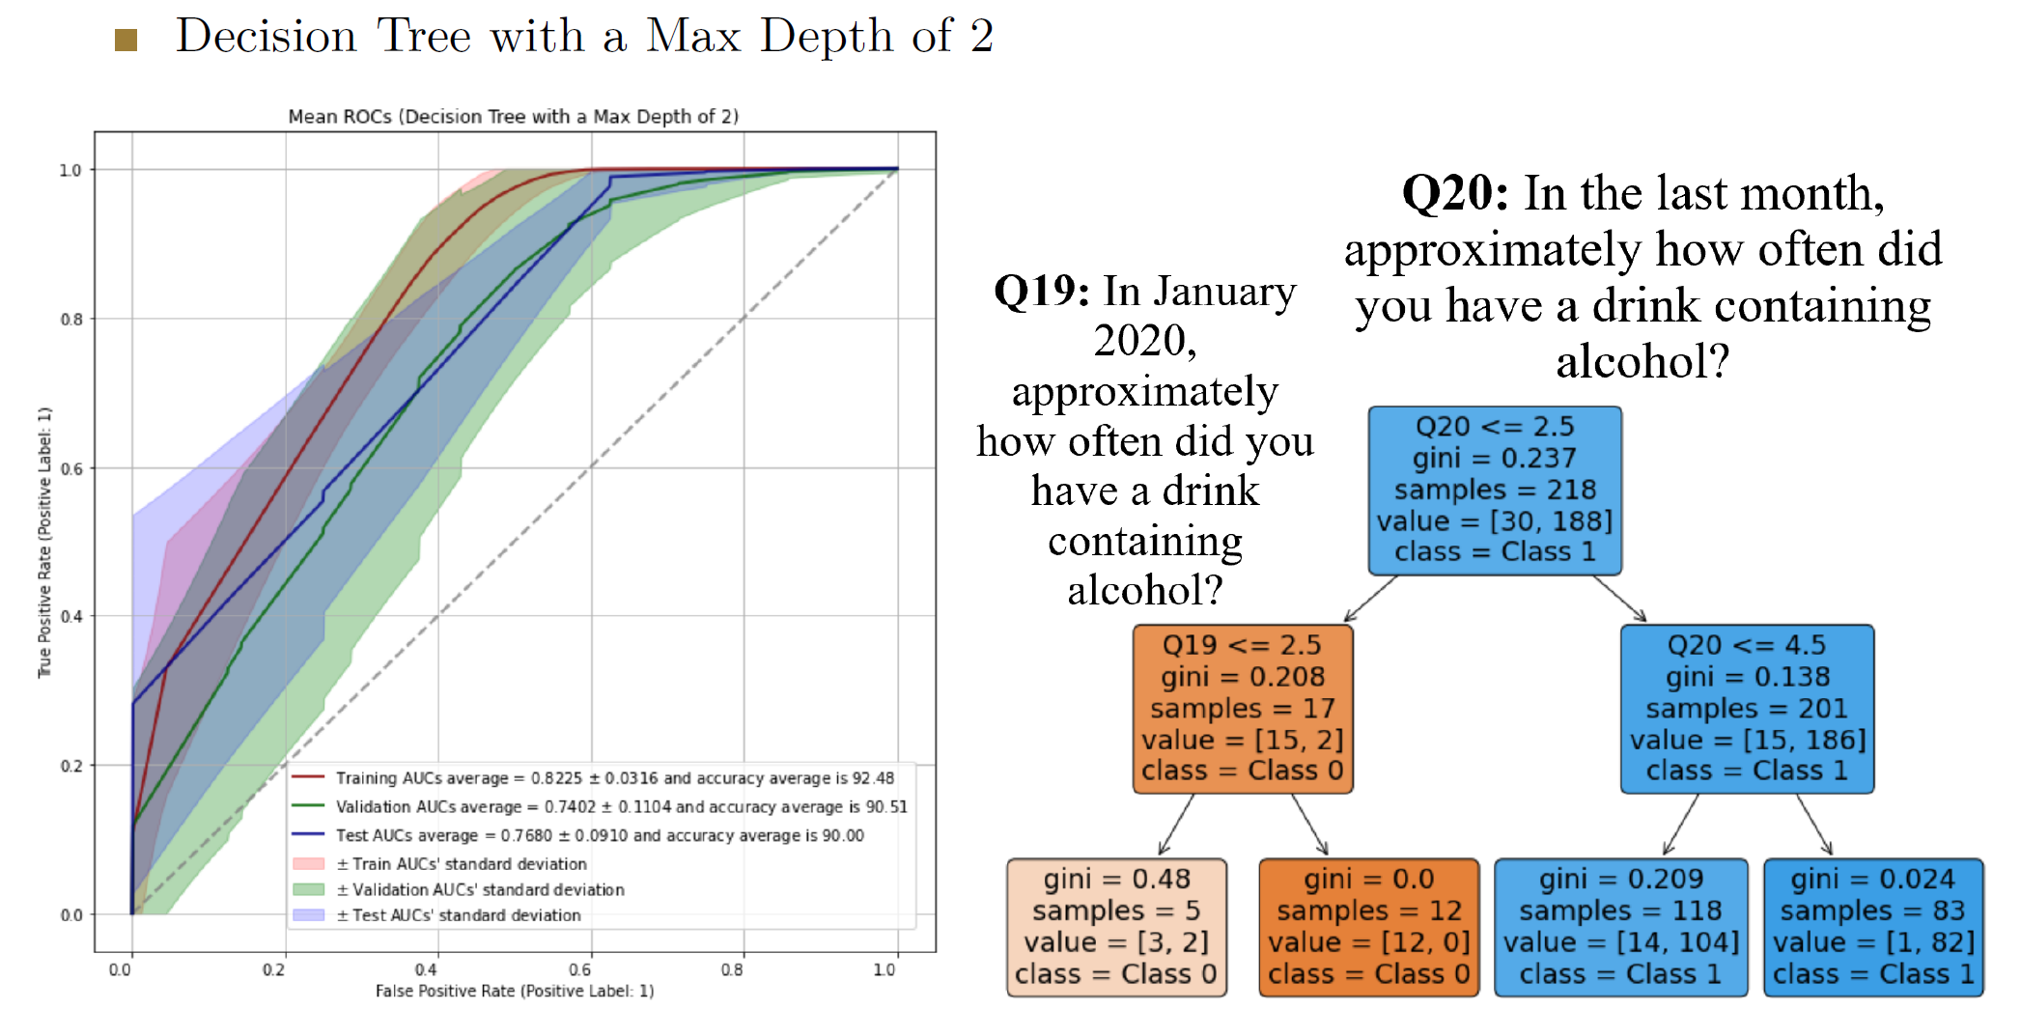

Slide 58
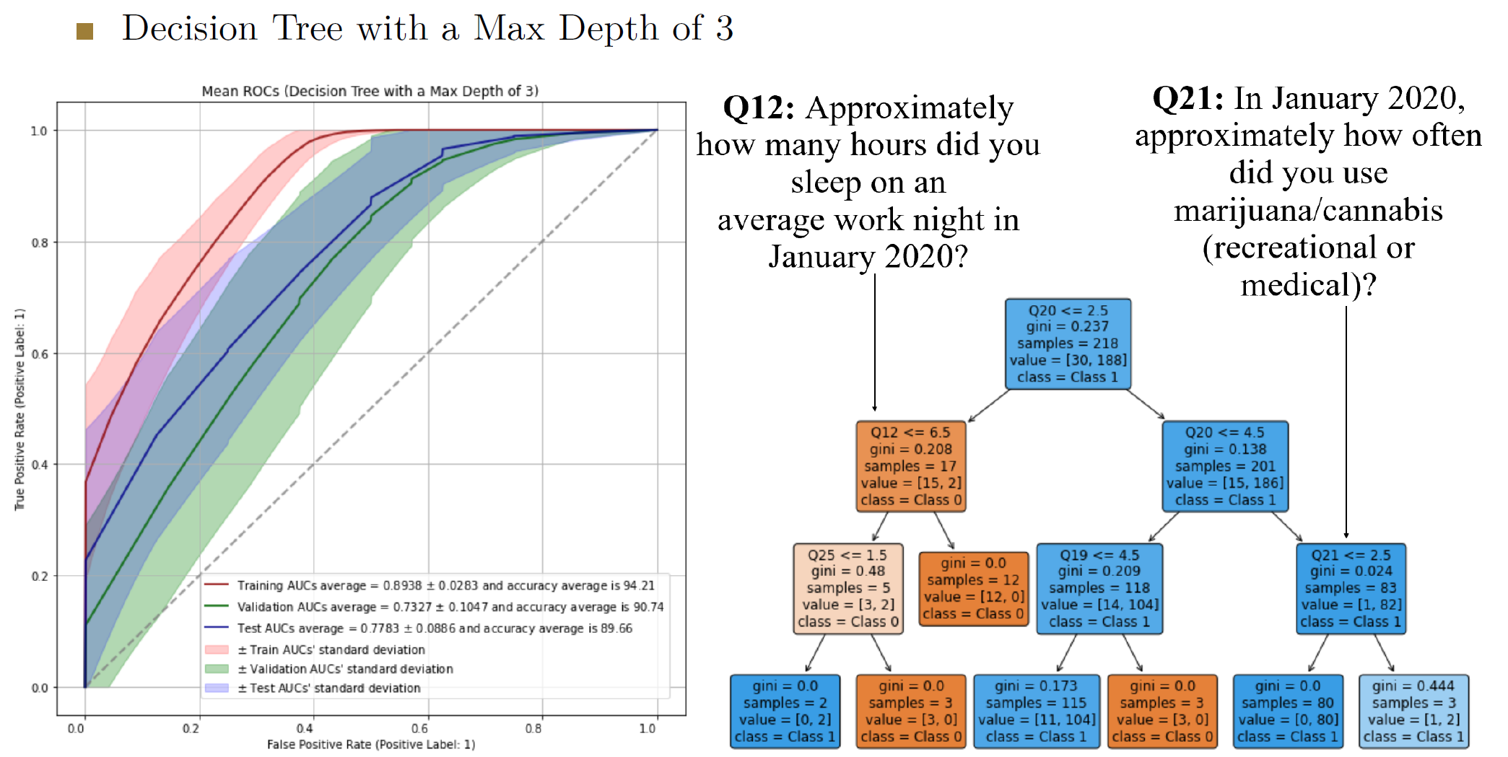

Slide 59
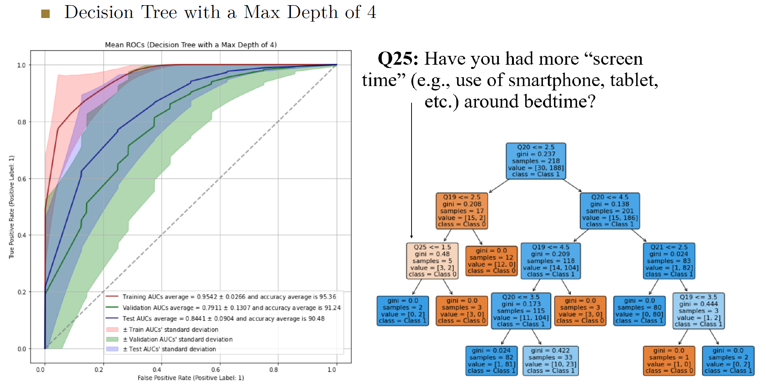

Slide 60
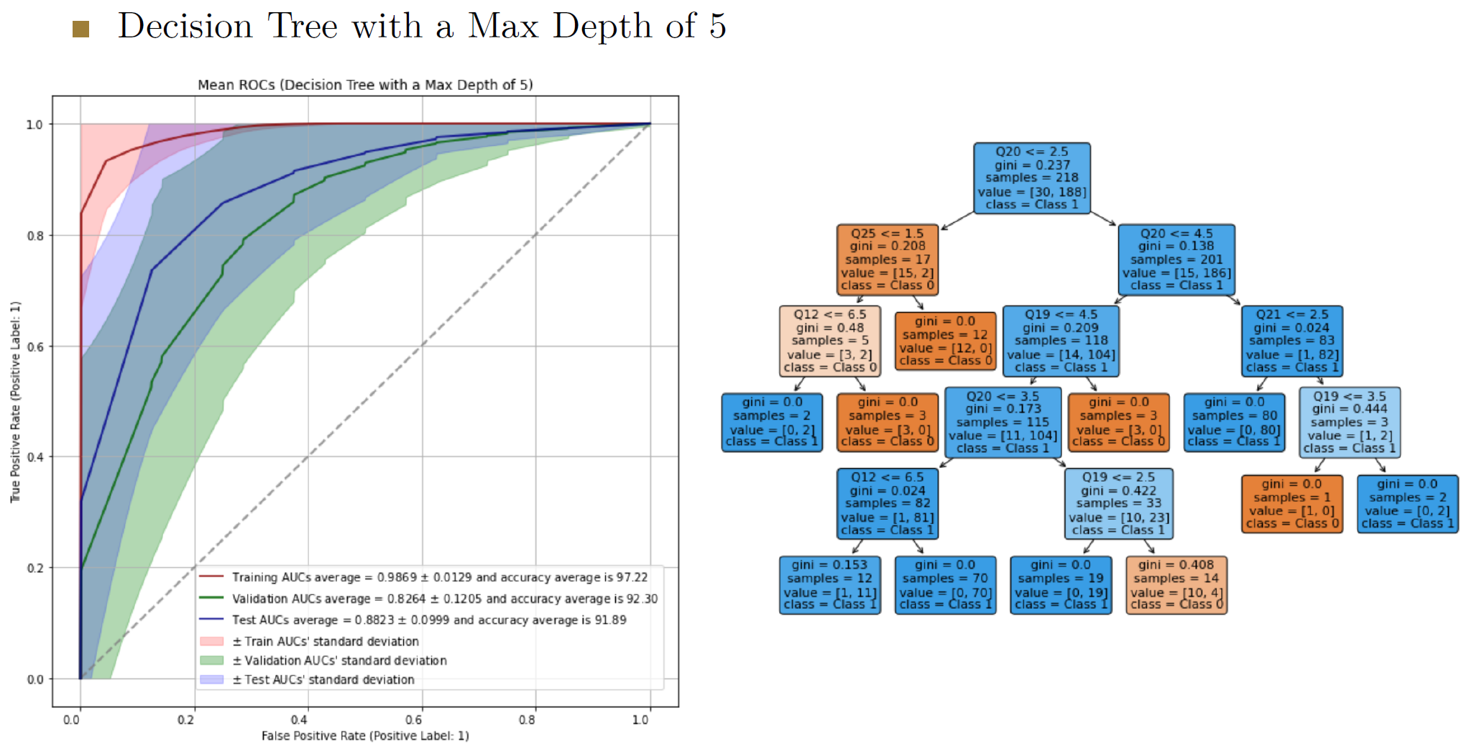

Slide 61


Slide 62


Slide 63


Slide 64


Slide 65


Slide 66


Slide 67


Slide 68


Slide 69

Table 1. The performance of multi-layer perceptron with two hidden layers containing 5 nodes (MLP), support vector machines (SVM), logistic regression (LR), decision tree with maximum depth of 3 (DT-3), decision tree with maximum depth of 4 (DT-4), and decision tree with maximum depth of 5 (DT-5), before and afer SMOTE is applied on training dataset (SMOTE was not applied on Validation or Test sets).

Slide 70

Table 2. The performance of Random Forest with 4 trees of maximum depth equals 3 (RF-4–3), Random Forest with 5 trees of maximum depth equals 3 (RF-5–3), Random Forest with 6 trees of maximum depth equals 3 (RF-6–3), XGBoostClassifer with 4 trees of maximum depth equals 3 (XGB-4–3), LightGBMClassifer with 4 trees of maximum depth equals 3 (LGBM-4–3), and CatBoostClassifer with 4 trees of maximum depth equals 3 (CAT-4–3), before and afer SMOTE is applied on training dataset (SMOTE was not applied on Validation or Test sets).

Slide 71
Hands-On Experience
20 minutes

Slide 72

Machine Learning on
Heart Disease Prediction
A DrivenData competition: Predicting Heart Disease: https://www.drivendata.org/competitions/54/machine-learning-with-a-heart/
Acknowledgment: Thanks to Dr. Hao Lu for bringing our attention to this dataset as a good example for hands-on experience.

Slide 73
There are 14 columns in the dataset:
age (type: int): age in years (age)
sex (type: binary): 0: female, 1: male (sex)
chest_pain_type (type: int): chest pain type (4 values) (cp)
resting_blood_pressure (type: int): resting blood pressure (trestbps)
serum_cholesterol_mg_per_dl (type: int): serum cholestoral in mg/dl (chol)
fasting_blood_sugar_gt_120_mg_per_dl (type: binary): fasting blood sugar > 120 mg/dl (fbs)
resting_ekg_results (type: int): resting electrocardiographic results (values 0,1,2) (restecg)
max_heart_rate_achieved (type: int): maximum heart rate achieved (beats per minute) (thalach)
exercise_induced_angina (type: binary): exercise-induced chest pain (0: False, 1: True) (exang)
oldpeak_eq_st_depression (type: float): oldpeak = ST depression induced by exercise relative to rest, a measure of abnormality in electrocardiograms (oldpeak)
slope_of_peak_exercise_st_segment (type: int): the slope of the peak exercise ST segment, an electrocardiography read out indicating quality of blood flow to the heart (slop)
num_major_vessels (type: int): number of major vessels (0-3) colored by flourosopy (ca)
thal (type: categorical): results of thallium stress test measuring blood flow to the heart, with possible values normal, fixed_defect, reversible_defect (thal)

Slide 74


Slide 75



Slide 76


Slide 77


Slide 78



Slide 79

XGBoost (eXtreme Gradient Boosting) is an advanced implementation of gradient boosting algorithm.
Tree pruning: Unlike GBM, it starts with a max size tree and prunes it backward, making it more efficient. Built-in cross-validation at each iteration.

Slide 80
Question 1: Impact of Tree Depth on Model Overfitting
Task: Using the provided Decision Tree code, modify the range of max_depth values to include deeper trees (e.g., from 2 to 30). Plot the training and test accuracies.
Objective: Observe how increasing the depth of the trees affects the training and test accuracies.
Discussion: Discuss why deeper trees might lead to overfitting.

Slide 81


Slide 82
Question 2: Exploring the Effect of the Number of Trees in a Random Forest
Task: In the Random Forest code, change the n_estimators parameter to see how the number of trees affects model performance. Start with a small number of trees (e.g., 1 to 10) and increase to a much larger number (e.g., 100 to 200).
Objective: Generate and compare the accuracy and AUC plots for both small and large numbers of trees.
Discussion: Identify at what point increasing the number of trees yields diminishing returns in terms of accuracy and AUC.

Slide 83


Slide 84
Question 3: Combining Tree Depth and Number of Trees in Random Forest
Task: Modify the Random Forest script to include a variable tree depth (e.g., max_depth ranging from 2 to 10) while also varying the number of trees.
Objective: Produce a series of plots (or a 3D plot if possible) that shows how both the number of trees and the depth of the trees simultaneously affect the accuracy and AUC.
Discussion: Find an "optimal" configuration of max_depth and n_estimators that provides the best balance between accuracy, and AUC.

Slide 85



Slide 86



Slide 87
Brief Introduction to other ML models

Slide 88


Support Vector Machines (SVM):
SVM aims to find the best hyperplane that separates the data points of different classes with the largest possible margin.
It is a binary classification algorithm but can be extended to handle multi-class classification problems.
SVM works by mapping the input data into a higher-dimensional feature space and finding an optimal hyperplane that maximally separates the classes.
The points closest to the hyperplane are called support vectors, which are crucial in defining the decision boundary.
SVM can handle both linearly separable and non-linearly separable data through the use of different kernel functions.
Common kernel functions include linear, polynomial, and radial basis function (RBF).
https://gfycat.com/gifs/search/svm
https://torchbearer.readthedocs.io/en/0.1.7/examples/svm_linear.html

Slide 89


The Iris dataset:
Used for classification tasks and benchmarking different algorithms.
Contains measurements of four features of Iris flowers: sepal length, sepal width, petal length, and petal width.
Consists of three different species of Iris flowers: setosa, versicolor, and virginica.
Each species has 50 samples, making a total of 150 samples in the dataset.
Each sample is represented by a row of data with the four feature measurements.
Goal is typically to classify or predict the species of an Iris flower based on its feature measurements.

Slide 90



Slide 91


Slide 92


Slide 93


Slide 94


Slide 95


Slide 96


Slide 97


Slide 98


Slide 99


Slide 100


Slide 101


Slide 102


Slide 103


Slide 104


Slide 105


Slide 106


Slide 107
Questions?
Dr. Mostafa Rezapour
Email: mrezapou@wakehealth.edu

